Slide 1
How to Move from Ingress to Gateway API with Minimal Hassle
Keith Mattix -Microsoft

Slide 2
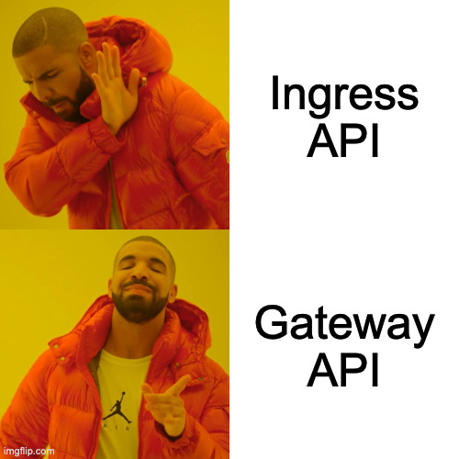
Notes:
As you've probably heard by now, Gateway API is the new standard for L7 traffic management in Kubernetes. Now, the Ingress API isn't going away, but it has been frozen and all new development/new adoption is being redirected to Gateway API. I'm not going to go through all of the features during this talk because there are so many other amazing speakers at this conference who are going to walk you through everything you need to know about using Gateway API. What I want to talk to you about is how you get there if you're already using Ingress

Slide 3

Notes:
Now when you read the title of this talk, something like this probably popped into your mind. "Oh this Keith guy's got this simple technique that's gonna make this completely painless". Well I regret to inform you...

Slide 4
Notes:
...that this isn't that. Unfortunately there's no simple solution to make things go perfectly. But what I hope to leave you with today is a strategy to help you head into a migration with all of the tools you need to be successful.

Slide 5
Refresher: the Ingress API
One API – 2 Resources:
Ingress – Describes the (usually L7) routing logic for the application
IngressClass – Registers a specific controller name to
Declarative configuration for some infrastructure responsible for bringing traffic into Kubernetes
This is often a cloud load balancer
The API was marked as frozen about a year ago
New features are being developed in Gateway API
Not ideal for multi-tenant/multi-role environments
apiVersion: networking.k8s.io/v1 kind: Ingress metadata: name: minimal-ingress annotations: nginx.ingress.kubernetes.io/rewrite-target: / spec: ingressClassName: nginx-example rules: - http: paths: - path: /testpath pathType: Prefix backend: service: name: test port: number: 80
Notes:
Let's start with a high level overview of Ingress API. Even though we describe it as one API, it's actualy composed of 2 CRDs

Slide 6
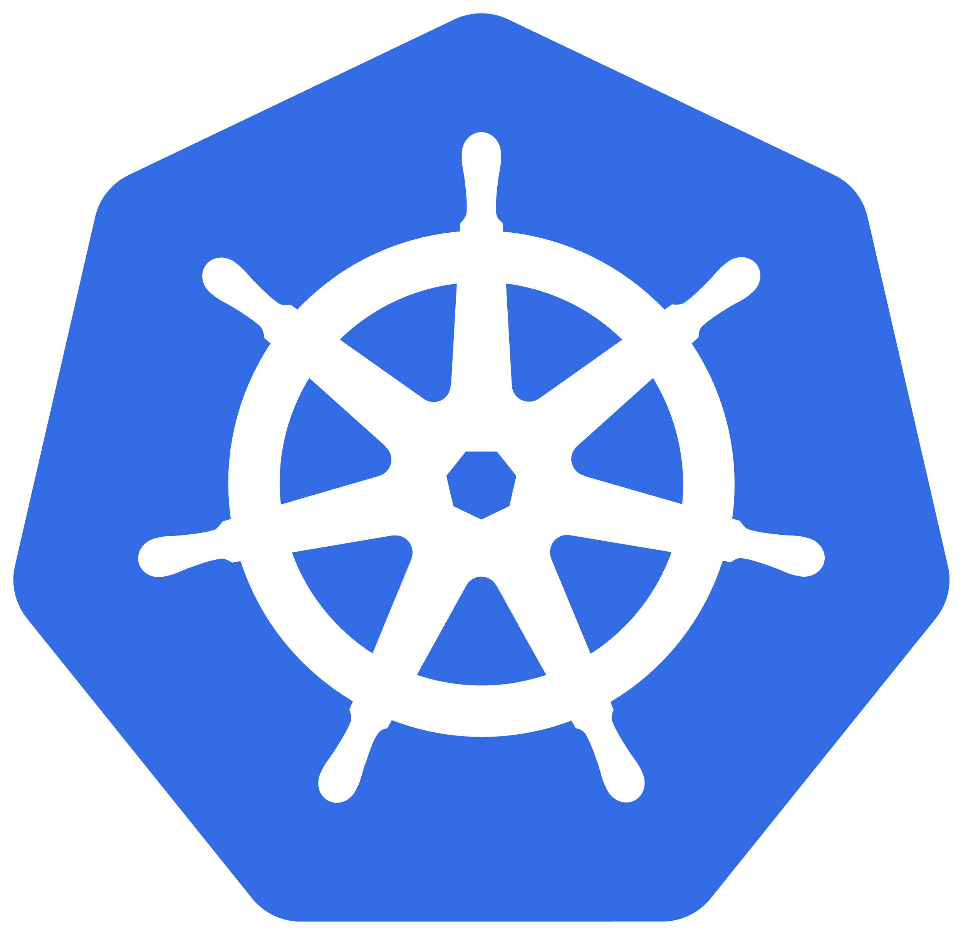




IngressClass
Ingress
Notes:
And this is how we typically see ingress resources applied. You've got a platform admin deploying the ingress controller and the ingress class and then app developers are able to create Ingress resources (often one per app!) for their applications

Slide 7
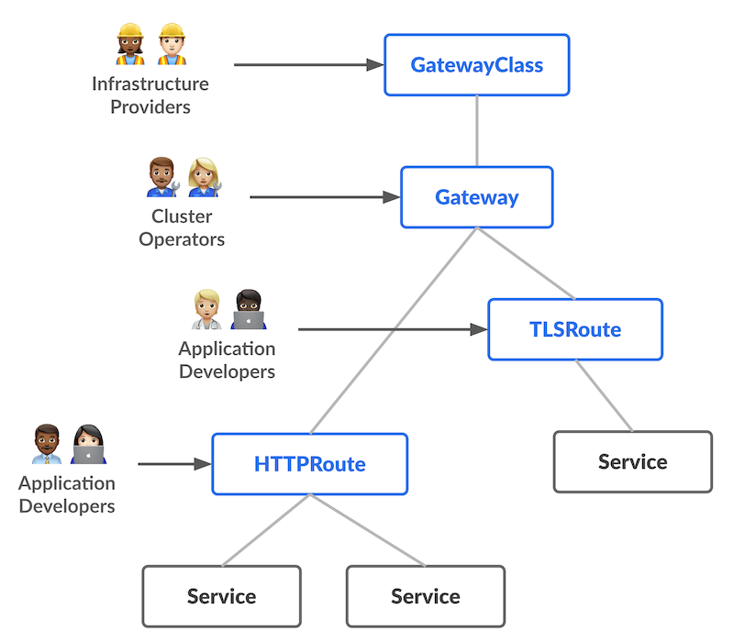
Enter: The Gateway API
Successor to Ingress – built from the ground up to support multiple personas
Graduated to GA ~1 year ago
20+ implementations
Distributed as CRDs instead of baked into Kubernetes
Allows for rapid iteration
Emphasis on strongly typed fields for functionality instead of annotations
Ensures configuration is portable across implementations
Still allows for implementation-specific functionality to run ahead of the API in a controlled way via extensions
Allows implementing multi-tenant scenarios in a more secure manner
Notes:
Now let's look at Gateway API
This is all great stuff, so obviously we want folks to move over from Ingress to Gateway APi

Slide 8
Who Likes Migrations???
Notes:
I mean when you ask your local sysadmin, devops or platform engineer to perform a migration, they're not happy

Slide 9


Slide 10

Notes:
Your local sysadmin, devops or platform engineer when they hear the word migration

Slide 11

Notes:
Your local sysadmin, devops or platform engineer when they hear the word migration

Slide 12

Notes:
Your local sysadmin, devops or platform engineer when they hear the word migration

Slide 13
The Unfortunate Truth of Migrations
Everyone wants new functionality, but migrations suuuck
If it goes wrong, the status quo of the business is disrupted for yet unrealized value
When the network is involved, migrations can be even riskier
Very hard to fail gracefully in the face of network failures
With Gateway API specifically, there's a whole new model to learn
One resource vs. Multiple resources
The design that makes it more secure and robust also adds a tad more complexity
Your organization may not have all the personas Gateway API is built for
Notes:
Status quo disrupted for yet unrealized value – this means that there are $$$ and customer trust lost for benefits that you can't see yet (because you haven't completed the migration yet).
Networks fail in very brutal ways, and it can leave customers feeling veery frustrateed

Slide 14
Principles for a Safe Migration
Plan to succeed through failure
Create a process for identifying failures and integrate it with your culture
Avoid "big switches"
Data, data, and more data
Confirm your observability strategy before you change a thing!
Figure out who in your organization fits what Gateway API persona
One person may wear multiple hats! But understand this ahead of time
Leverage the community for best practices
GitHub Issues/Discussions and Slack are great places to look for examples
Notes:
To be successful in any migration (not just Ingress -> Gateway API), you need to have the right mindset, so here are some general principles that I've found helpful in the past
1. Plan to succeed through

Slide 15
Tools for your Journey

Slide 16
Ingress2Gateway
Ingress2gateway helps translate Ingress and provider-specific resources (CRDs) to Gateway API resources
Supports multiple providers:
apisix
ingress-nginx
istio
gce
kong
openapi
./ingress2gateway print
Use this to scaffold your Gateway API resources!

Slide 17

Ingress2gateway Demo

Slide 18
Weighted DNS/Routing
Use a DNS provider or CDN layer to switch to a new load balancer/IP address
Start with 1-5% of traffic going to the Gateway API LB and monitor for errors
Cloudflare, Fastly, AWS Route53, Azure DNS + Traffic Manager, Google Cloud DNS, etc.
Note that you'll need to coordinate the change across security boundaries like firewalls, etc.
Goal here is to shoot for zero-downtime migrations
Some traffic management solution is required

Slide 19



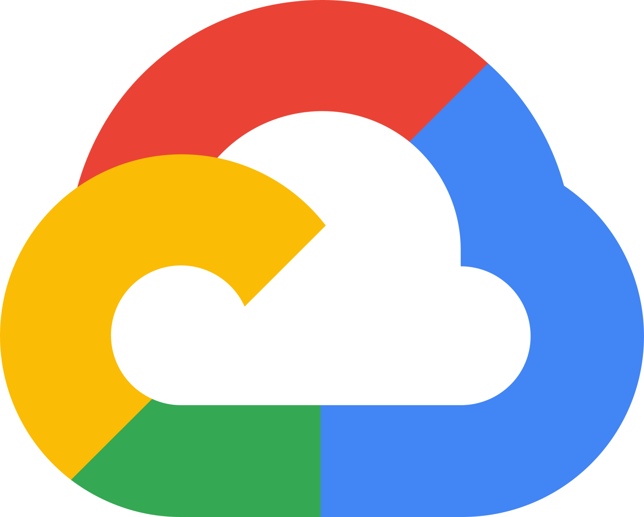
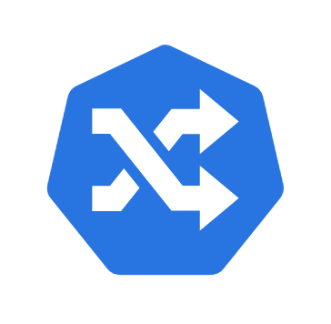
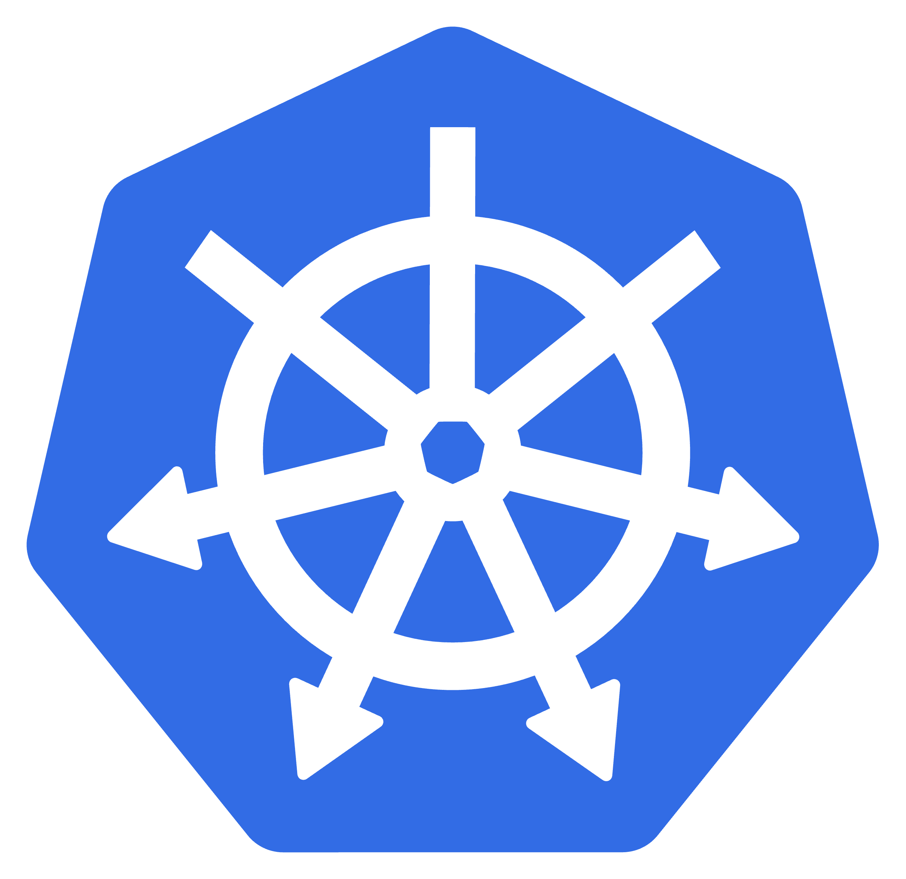

Weighted DNS/Routing
50%
50%
Ingress
Gateway API
Backend Pods
Notes:
So let’s walk through the traffic flow: first traffic will hit your CDN/DNS layer which will perform weighted routing when your a

Slide 20
Questions?

